Slide 1
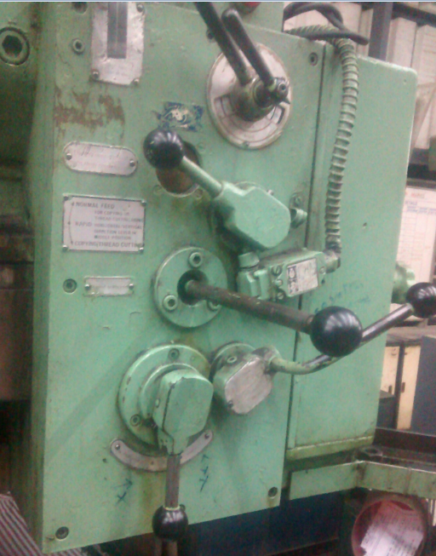
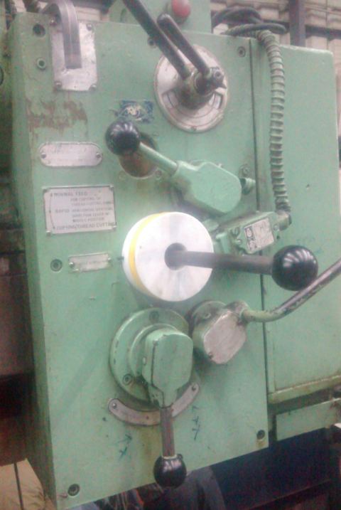
POKA YOKE Instant switching mechanism to avoid accident as well as energy conservation in B bldg Copper CVT150 VTL
Before :
After:
Once main control ON ,Rapid drive motor running continually, if it is required or not
Rapid drive motor will switch ON only when it is required by means of instant switching mechanism .
Instant switching mechanism to control turret movement
Turret Rapid drive lever

Slide 2
Cost For Implementation
All required thinks were taken from existing source.
If there need to get it from out side , then the cost will be Rs 1500
Benefits :
Safety ensured by pool proofing (POKA YOKE) rapid drive mechanism
96.67% Energy cost conserved
Noise pollution totally avoided

Slide 3
Energy Cost Calculation
Machine running hrs / day out of 2 shift :15Hrs.
Max Rapid drive usage will be : 0.5Hrs.
Which means the rapid drive motor has been running 14.5 hrs unnecessarily. Now we have recovered this waste energy by introducing a POKAYOKE
 | Before | After | Units
Motor capacity | 1.5 | 1.5 | KW
Running hrs. /day | 15 | 0.5 | hrs
Energy consumption / day | 22.5 | 0.75 | Units
Energy consumption / month | 585 | 19.5 | Units
Energy cost / month | 4095 | 136.5 | Rs.
Energy cost / annuam | 49140 | 1638 | Rs.
Cost saving / annuam / Machine | 47502 |  | Rs.
Horizontal deployment possible : 3 nos. at MPK alone

